Slide 1
A First Book of ANSI C Fourth Edition
Chapter 7
Modularity Using Functions: Part II

Slide 2
Objectives
Variable Scope
Variable Storage Class
Pass by Reference
Case Study: Swapping Values
Recursion
Common Programming and Compiler Errors

Slide 3
Variable Scope
If variables created inside a function are available only to the function itself, they are said to be local to the function, or local variables
Scope is the section of the program where the variable is valid or “known”

Slide 4
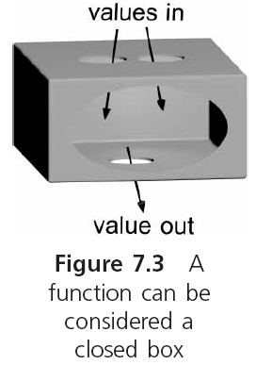
Variable Scope (continued)

Slide 5
Variable Scope (continued)
A variable with a local scope has had storage set aside for it by a declaration statement made within a function body
A variable with global scope is one whose storage has been created for it by a declaration statement located outside any function

Slide 6
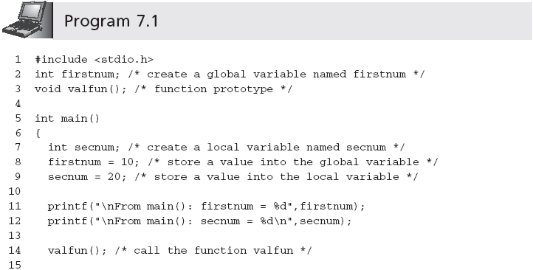
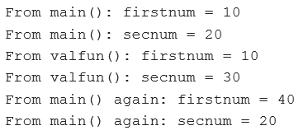
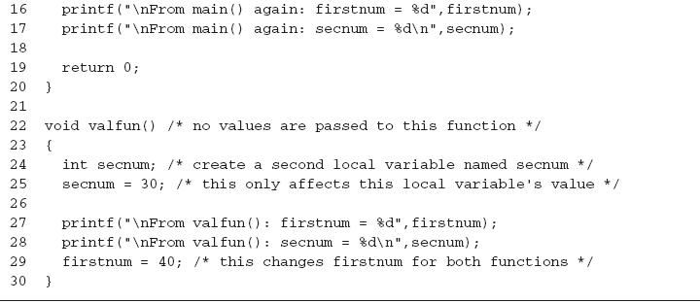
Variable Scope (continued)

Slide 7
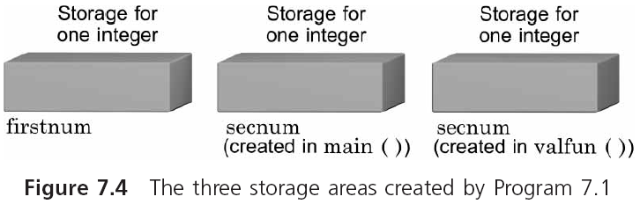
Variable Scope (continued)

Slide 8
Variable Scope (continued)
While a function is executing, only the storage area for the variables and parameters created by this function are automatically accessed
If a variable that is not local to the function is used by the function, the program searches the global storage areas for the correct name

Slide 9
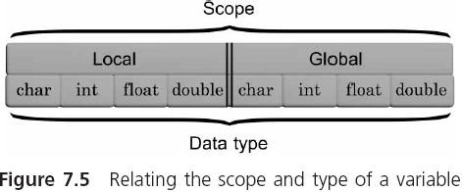
Variable Scope (continued)
The scope of a variable does not influence the data type of the variable

Slide 10
When to Use Global Declarations
The scoping rules for symbolic constants and function prototypes are the same as for variables
When a symbolic constant has a general meaning that is applicable throughout an application, it makes good programming sense to declare it globally at the top of a source code file

Slide 11
When to Use Global Declarations
Coding a function prototype as a global makes sense when the function is used by a number of other functions in a source code file
Doing so avoids repeating the prototype within each of the functions that will call it

Slide 12
Misuse of Global Variables
Except for symbolic constants and prototypes, global variables should almost never be used
By making a variable global, you instantly destroy the safeguards C provides to make functions independent and insulated from each other
Using global variables can be especially disastrous in large programs with many user-created functions
Because a global variable can be accessed and changed by any function following the global declaration, it is a time-consuming and frustrating task to locate the origin of an erroneous value

Slide 13
Variable Storage Class
In addition to the space dimension represented by its scope, variables also have a time dimension
Called the variable’s “lifetime”
Where and how long a variable’s storage locations are kept before they are released can be determined by the storage class of the variable
auto, static, extern, and register

Slide 14
Variable Storage Class (continued)
Examples:
auto int num;
static int miles;
extern int price;
register int dist;
auto float coupon;
static float yrs;
extern float yld;
auto char inKey;

Slide 15
Local Variable Storage Classes-auto
Local variables can only be members of the auto, static, or register storage classes
auto is the default class used by C
The term auto is short for automatic
Storage for automatic local variables is automatically reserved each time a function declaring automatic variables is called
As long as the function has not returned control to its calling function, all automatic variables local to the function are “alive”; that is, storage for the variables is available

Slide 16
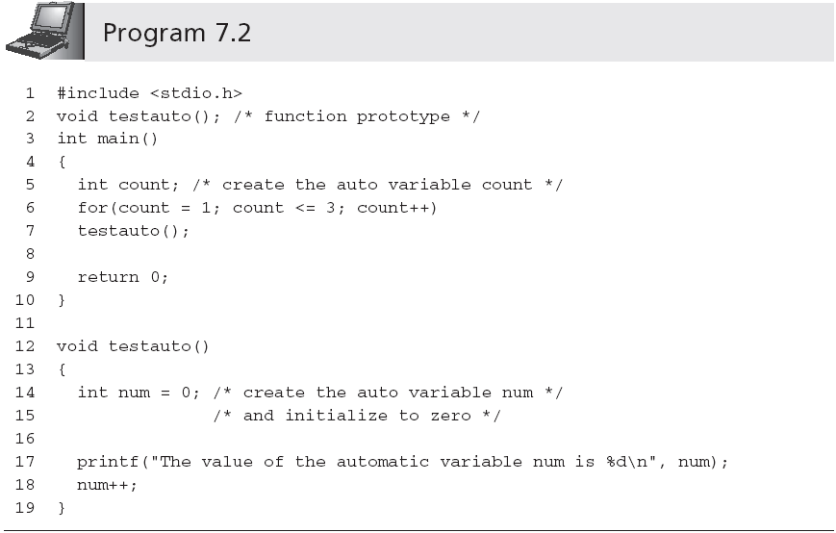
Output is:
The value of the automatic variable num is 0
The value of the automatic variable num is 0
The value of the automatic variable num is 0

Slide 17
Explanation in TC
static: Preserves variable value.
A function or data element is only known within the scope of the current compile.
If you use the "static" keyword with a variable that is local to a function, it allows the last value of the variable to be preserved between successive calls to that function
once created, local static variables remain in existence for the life of the program.

Slide 18
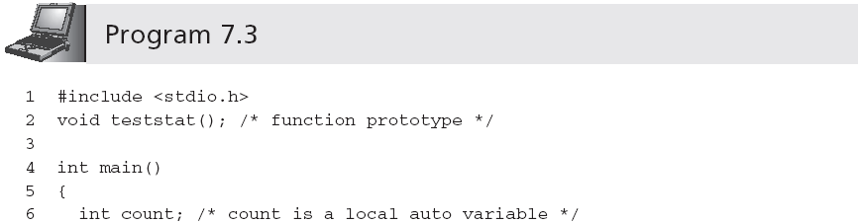
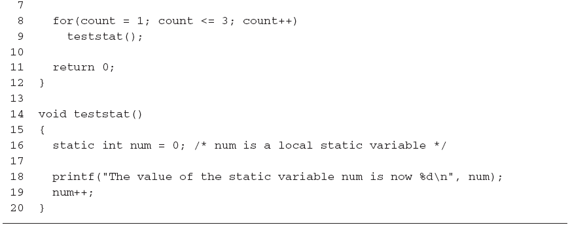
Static variable num is set to 0 only once
Output is:
The value of the static variable num is now 0
The value of the static variable num is now 1
The value of the static variable num is now 2

Slide 19
Local Variable Storage Classes-static
A local variable declared as static causes the program to keep the variable and its value even when the function that declared it is done
Once created, local static variables remain in existence for the life of the program
Static variables are not initialized at run-time
The initialization of static variables is done only once, when the program is first compiled
Some compilers initialize local static variables the first time the definition statement is executed rather than when the program is compiled

Slide 20
Static
Unlike, automatic variables, static can only be initialized by either constants or constant expression， such as 3.2 + 8.0.
All static variables are set 0 when no explicit initialization is given.

Slide 21
Local Variable Storage Classes-Register
Register variables have the same time duration as automatic variables
register int time;
Registers are high-speed storage areas physically located in the computer’s processing unit

Slide 22
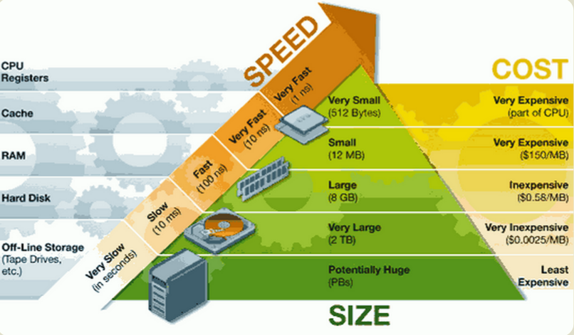
Fast
CPU Register
Cache
RAM
Hard Disk
Off-Line Storage
(Tape)
Slow

Slide 23
Local Variable Storage Classes-Register
Application programs rarely, if ever, should use register variables
Variables declared with the register storage class are automatically switched to auto if the compiler does not support register variables or if the declared register variables exceed the computer’s register capacity

Slide 24
Global Variable Storage Classes
Global variables are created by declaration statements external to a function
They exist until the program in which they are declared is finished executing
Global variables are declared static or extern
extern int sum;
static float yield;
The purpose of the extern storage class is to extend the scope of a global variable declared in one source code file into another source code file

Slide 25
extern
extern: Indicates that the actual storage and initial value of a variable, or body of a function, is defined elsewhere, usually in a separate source code module.
The keyword extern is optional for a function prototype

Slide 26
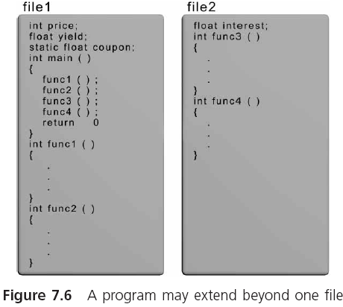
Global Variable Storage Classes

Slide 27
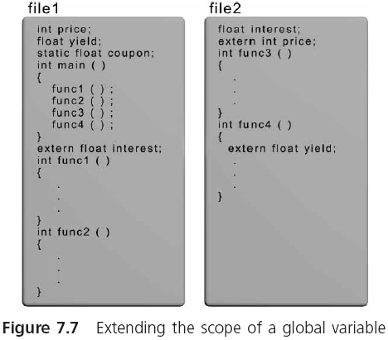

Slide 28
Global Variable Storage Classes
Declaration statements containing the word extern do not create new storage areas; they only extend the scope of existing global variables
The static global class is used to prevent the extension of a global variable into a second file
The scope of a global static variable cannot be extended beyond the file in which it is declared
Provides some privacy for static global variables

Slide 29
Pass by Reference
In pass by value, a called function receives values from its calling function, stores the passed values in its own local parameters, manipulates these parameters appropriately, and directly returns, at most, a single value
Passing an address is referred to as a function pass by reference, because the called function can reference, or access, the variable using the passed address
Also referred to as a call by reference when the term applies only to those parameters whose addresses have been passed

Slide 30
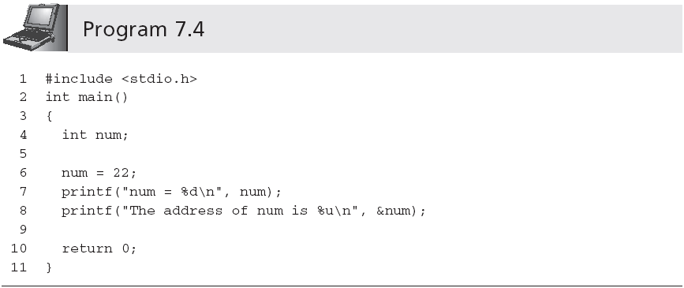
Passing Addresses to a Function
Output the unsigned int of decimal
Output is:
num = 22
The address of num is 124484

Slide 31
Storing Addresses
numAddr = &num;
A variable that can store an address is known as a pointer variable or pointer

Slide 32
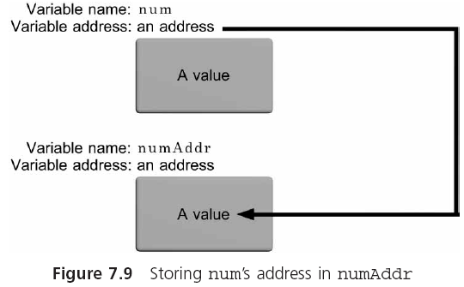
Storing Addresses (continued)

Slide 33
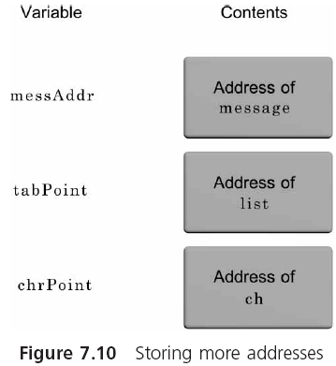
Storing Addresses (continued)
messAddr = &message
tabPoint = &list
chrPoint = &ch

Slide 34
Using Addresses
Indirection operator: *
*numAddr means the variable whose address is stored in numAddr
Or, the variable pointed to by numAddr
When using a pointer, the value obtained is always found by first going to the pointer for an address; this is called indirect addressing

Slide 35
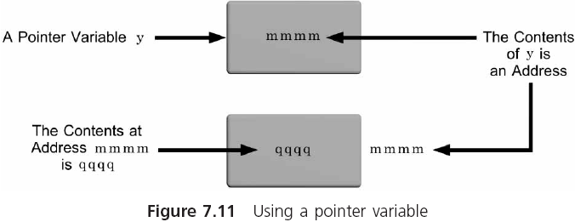
Using Addresses (continued)

Slide 36
Declaring and Using Pointers
In declaring a pointer variable, C requires that we also specify the type of variable that is pointed to
int *numAddr;
This declaration can be read in a number of ways: as：
the variable pointed to by numAddr is an integer,
or as numAddr points to an integer

Slide 37
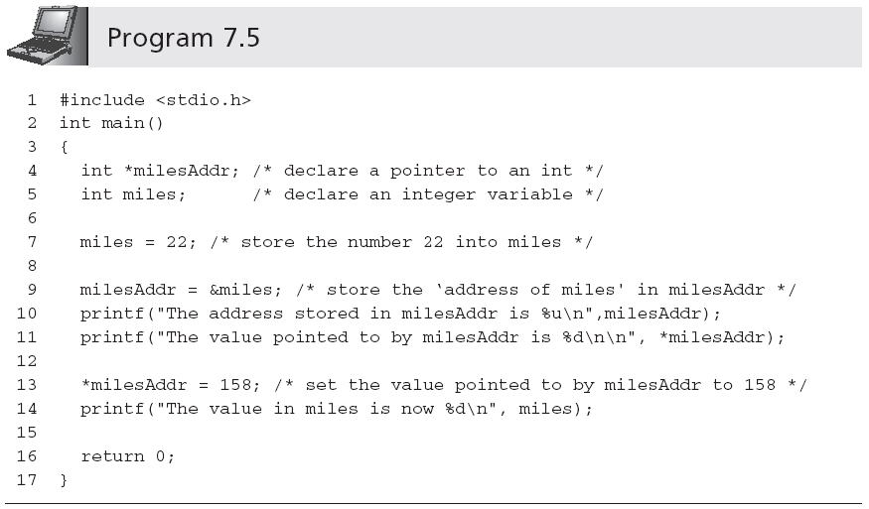
Declaring and Using Pointers (continued)

Slide 38
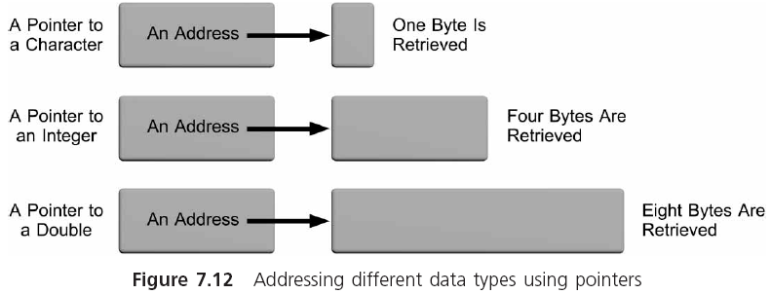
Declaring and Using Pointers (continued)

Slide 39
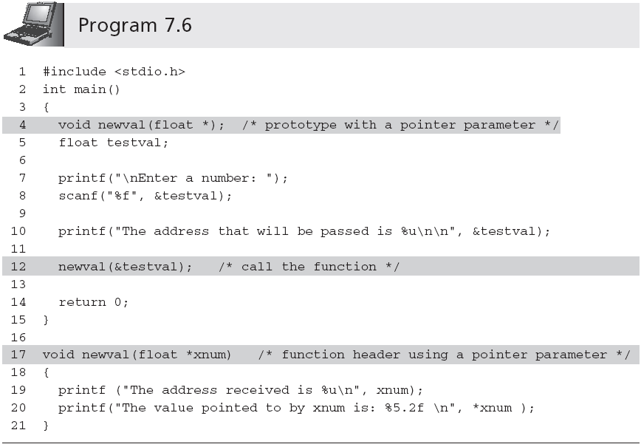
Passing Addresses to a Function
&

Slide 40
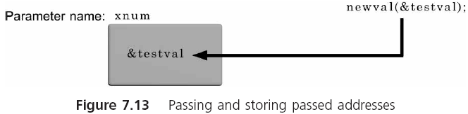
Passing Addresses to a Function (continued)

Slide 41
Passing Addresses to a Function (continued)
Sample run of Program 7.6:
Enter a number: 24.6
The address that will be passed is 124484
The address received is 124484
The value pointed to by xnum is: 24.60

Slide 42
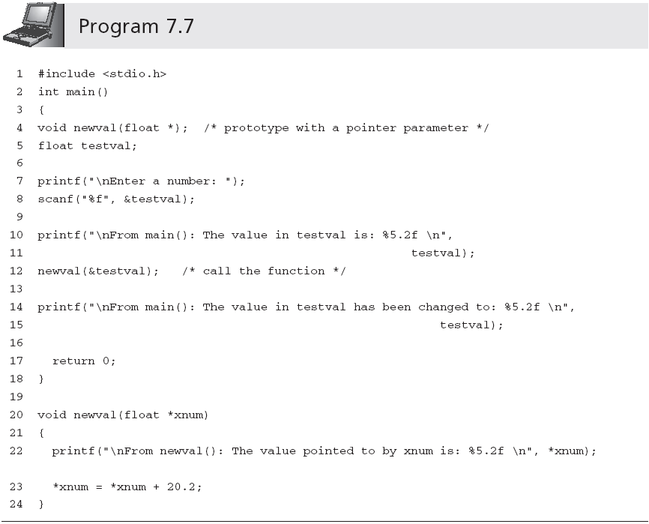
Passing Addresses to a Function (continued)
Add 20.2 to the value of the variable pointed to by xnum

Slide 43
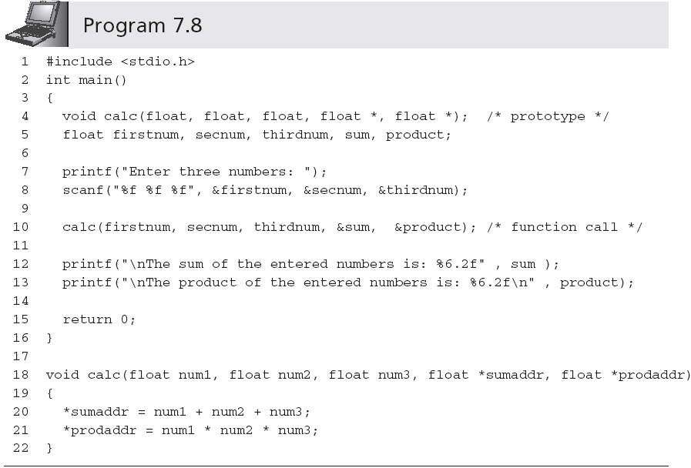
Passing Addresses to a Function
Returns multiple values

Slide 44
int total = 0;
for( int counter = 1; counter <= 10; counter++ )
{
total += counter*counter;
}
float avg = total/(counter-1);

Slide 45
{
int counter = 10;
}
float avg = 10/counter;

Slide 46
Case Study: Swapping Values
A common programming requirement is the sorting of both numeric values and text, such as names, in either ascending (increasing) or descending (decreasing) order
Typically accomplished by comparing two values and then switching values if they are not in the correct order

Slide 47
Requirements Specification
Write a C function that exchanges the values in two single-precision variables of its called function
Thus, if the function has access to two variables of its calling function, the called function should switch the values in these variables

Slide 48
Analyze the Problem
Input (arguments of the function): two addresses, of the two variables whose values are to be exchanged
Output: change the values in the calling function using passed addresses
Swapping the values of two variables is accomplished using the following algorithm:
Store the first variable’s value in a temporary location
Store the second variable’s value in the first variable
Store the temporary value in the second variable

Slide 49
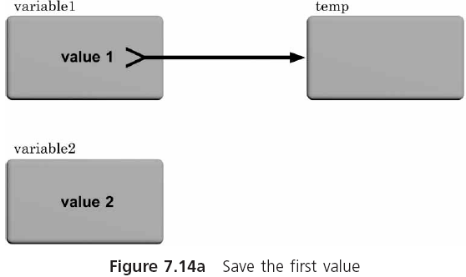
Analyze the Problem (continued)

Slide 50
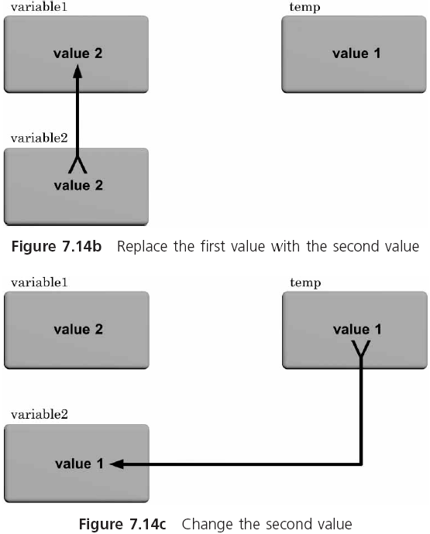
Analyze the Problem (continued)

Slide 51
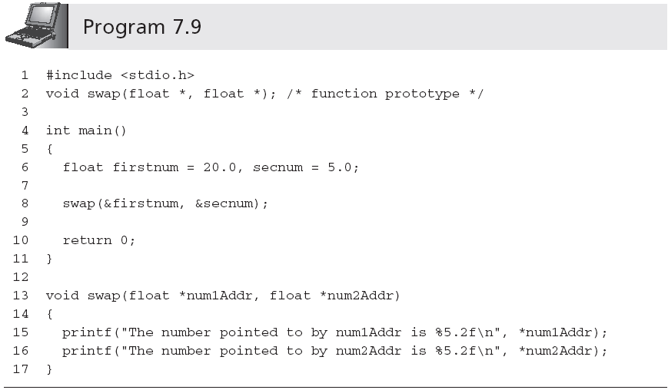
Code the Function

Slide 52
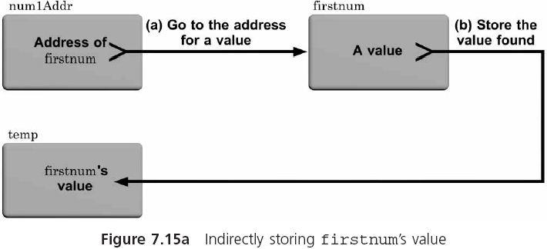
Code the Function (continued)

Slide 53
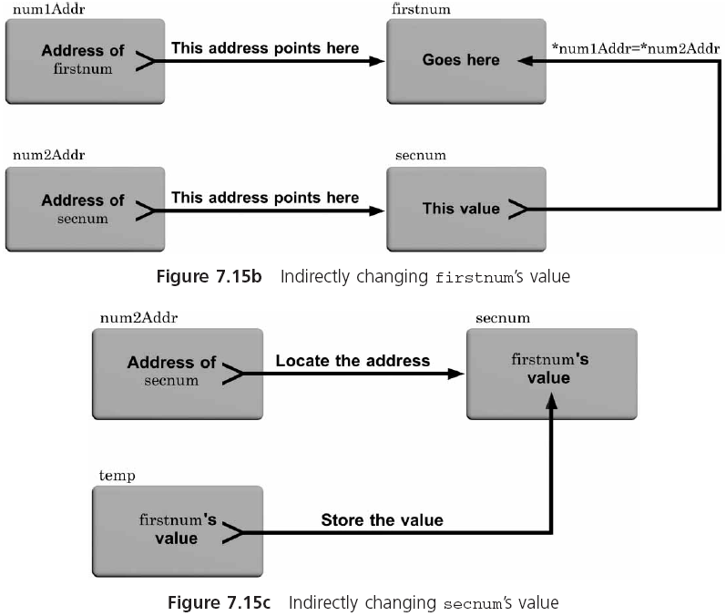

Slide 54
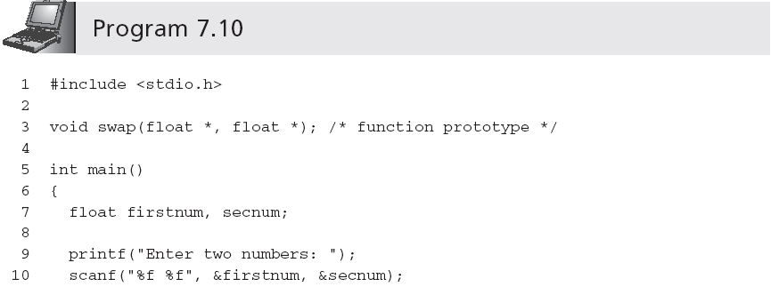
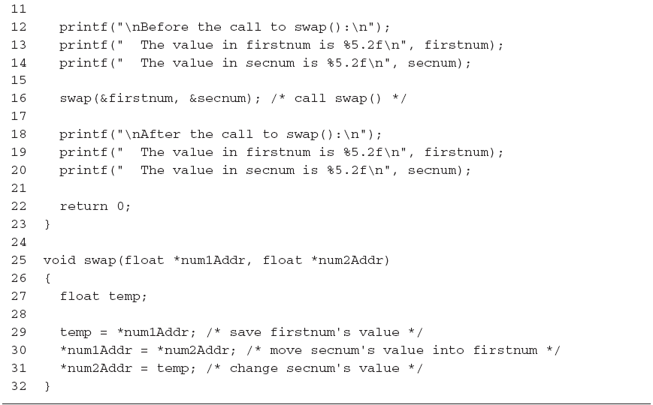

Slide 55
Test and Debug the Program
The following sample run was obtained using Program 7.10, which completes the verification:
Enter two numbers: 20.5 6.25
Before the call to swap():
The value in firstnum is 20.50
The value in secnum is 6.25
After the call to swap():
The value in firstnum is 6.25
The value in secnum is 20.50

Slide 56
Common Programming Errors
Using the same name for a local variable that has been used for a global variable
Becoming confused about whether a parameter (or variable) contains an address or is an address
Declaring a pointer as a function parameter and then forgetting to place the address operator, &, before the argument passed to the function when it is called
Forgetting to specify the initial case when a recursive function is defined

Slide 57
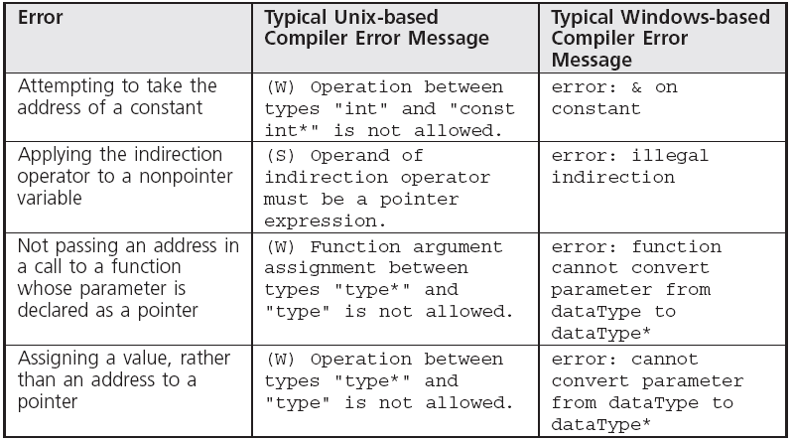
Common Compiler Errors

Slide 58
Summary
Every variable used in a program has scope, which determines where the variable can be used
Every variable has a class（auto、static、register、extern）
Every variable has a data type, a value, and an address
A pointer is a variable or parameter that is used to store the address of another variable

Slide 59
Summary
If a parameter or variable is a pointer, then the indirection operator, *, must be used to access the variable whose address is stored in the pointer
The address of a variable can be passed to a function

Slide 60
Summary (continued)
When a called function receives an address, it has the capability of directly accessing the respective calling function’s variable
A recursive solution is one in which the solution can be expressed in terms of a “simpler” version of itself

Slide 61
练习
（1）用户输入一个正整数N，编写一个独立函数生成1~N之间的随机数（练习函数编写与调用的方法）。
扩展练习，(a)输入正整数M>>N，统计1~N之间任意一个随机数出现的频率，验证它们是否相接近；可以使用整数指针存储每个随机数出现的次数，如int *p = (int*)malloc(N*sizeof(int))。
(b)将Main作为主控函数，初始化输入编写一个函数；随机数生成编写一个函数；频率统计编写一个函数；输出与资源清理编写一个函数(练习模块化编程)。
（2）将上次作业中阶乘求解算法，修改为递归实现。扩展练习：
(a)将求阶乘因子个数的算法编写为一个独立算法，并将该算法放到一个独立的文件中（也拥有独立的头文件）;
(b) 使用extern变量保存（a）中函数计算出的因子个数，共享到main函数中进行打印；
(c)增量阶乘计算，如7！=7*6*5！，可以使用static变量保存上次阶乘计算的相关数据与结果。

Slide 62
unsigned int improvedIncrementalFactorial(unsigned int startN, unsigned int endN, bool is = false )
{
static unsigned int lastN=1, lastFactorial = 1;
if( is )
{
if( lastN < endN )
{
unsigned int temp = lastN;
lastN = endN;
return (lastFactorial = lastFactorial*improvedIncrementalFactorial(temp, endN));
}else
return improvedIncrementalFactorial(1, endN);
} else
{
if( endN <= startN )
return 1;
else
return (endN*improvedIncrementalFactorial(startN, endN-1));
}
}
improvedIncrementalFactorial(1, 3, true);

